Slide 1
Statistical Analysis to Predict Terrorist Attacks
David Hyatt
The George Washington University
SEAS 6401
Dr. Ben Harvey
December 3, 2019

Slide 2
Overview
Define terrorism
Introduce data
Visualization of terrorist attack data information

Slide 3
Introduction
Use of intentional violence against civilians for a political purposes.
181,692 reported attacks between 1970-2017
171,378 reported deaths
In 2017, 3,781 reported attacks in the Middle East (34.6%)
In 2016, 21,534 deaths record in Iraq

Slide 4
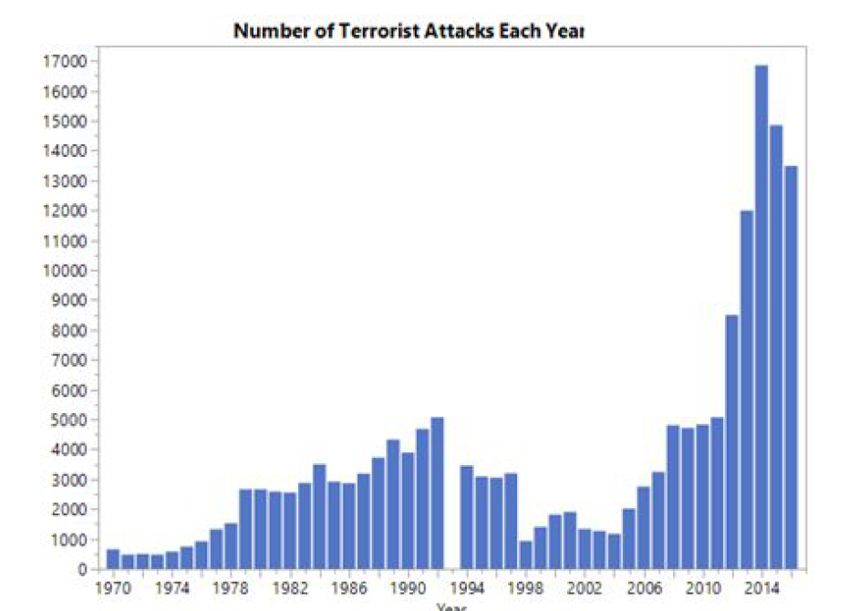
Bar Chart of Attacks Per Year

Slide 5
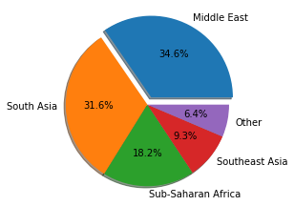
Pie Chart of Regions

Slide 6
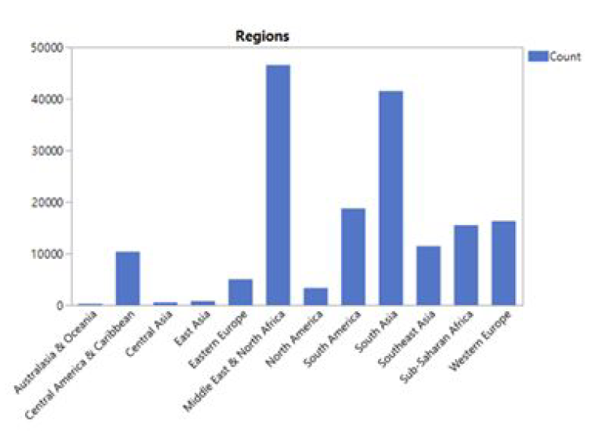
Bar Chart of Regions

Slide 7
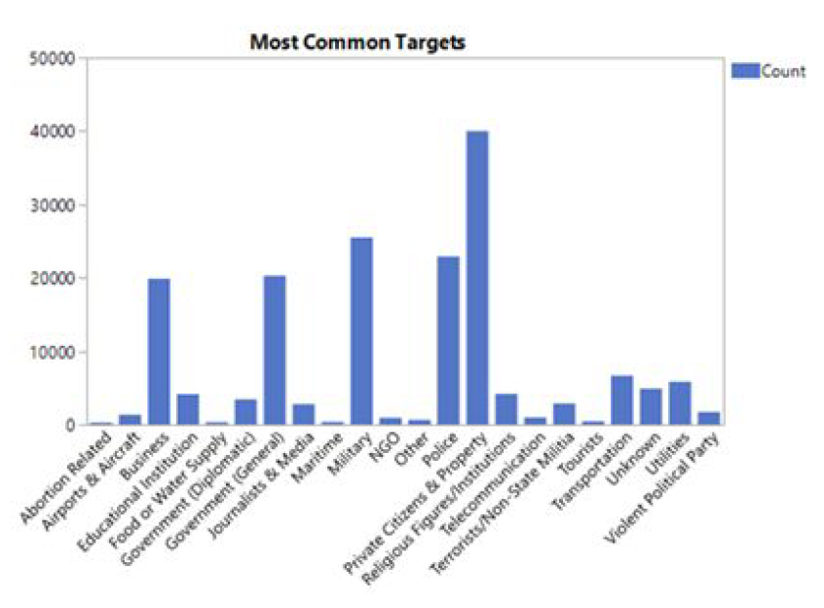
Targets

Slide 8
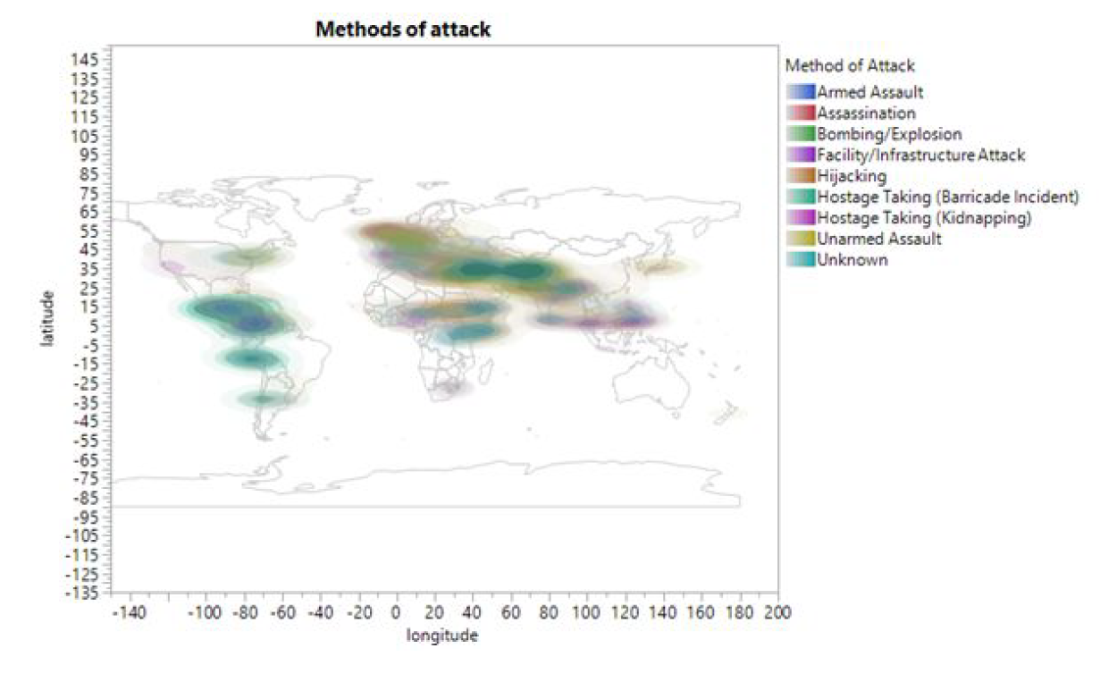
Heat Map of Attack Types

Slide 9
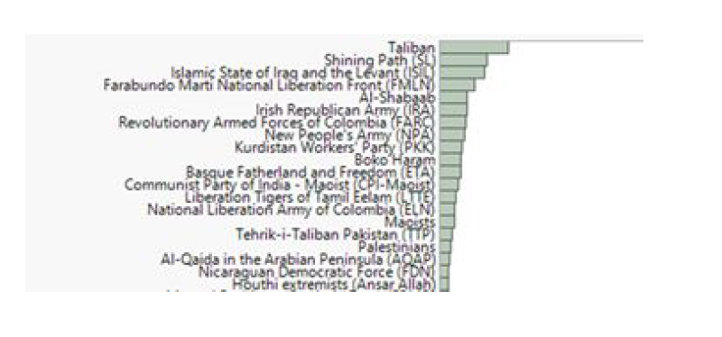
Terrorist Groups

Slide 10
Summary
34.6% of attacks occur in the Middle East
Since 2005, terrorist attacks have increased
Bombings/Explosions are most common method
Private citizens are number one target
Taliban is most recognized terrorist group.
ISIS is currently number three

Slide 11
Bibliography
Global Terrorism Database, 2018. https://www.kaggle.com/START-UMD/gtd

